Slide 1
Anti-Trans Myths
A Skeptics Introduction

Slide 2
My Background
USNA Class of 1997
SH-60B, P-3C Pilot
MS Operations Research, 2008
Left active duty in 2008
Left Reserves in 2010
Defense scientist / project manager Wright Patterson AFB since 2008
Writer for Salon, Huffington Post, Bilerico, Evereryday Feminism
On the boards of SPARTA, EO, PFLAG
Began transitioning in 2010
Finished transitioning early 2012
Married, three children
Live in Xenia, OH

Slide 3
101
Read / watch the articles / videos
Read the comments (Don’t try this at home)
3. Identify, catalog and count central myths
4. Identify the supporting evidence (if any) of the central arguments
5. Look at the sources of the supporting opposition evidence
6. State the truth first
7. Bust the central arguments with better evidence
8. Bust the supporting evidence, or identify how it misused actual science
9. Bust the sources of the supporting evidence

Slide 4
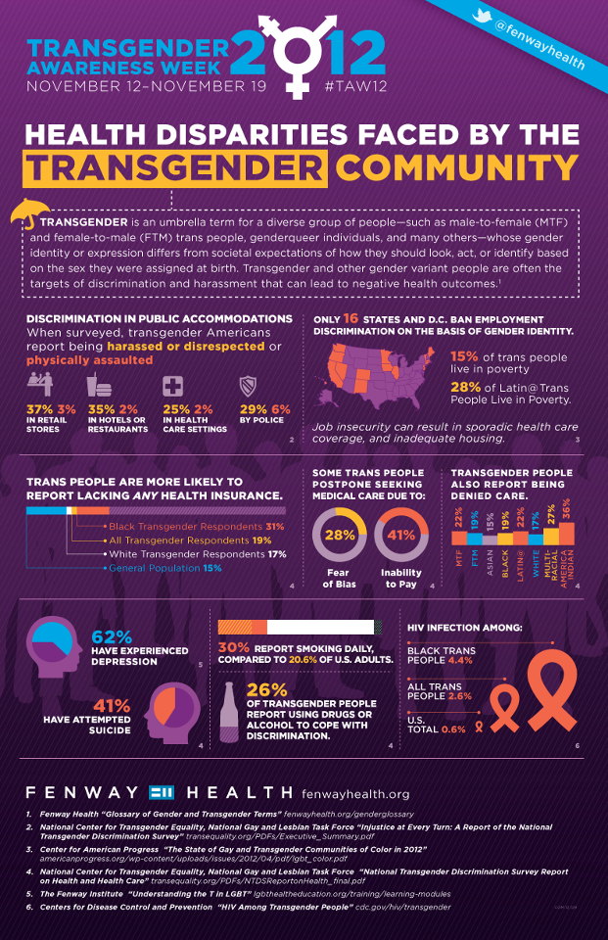
Anatomy of a Mythbusting: How to Present Information
Core facts—a refutation should emphasize the facts, not the myth. Present only key facts to avoid an Overkill Backfire Effect;
Explicit warnings—before any mention of a myth, text or visual cues should warn that the upcoming information is false;
Alternative explanation—any gaps left by the debunking need to be filled. This may be achieved by providing an alternative causal explanation for why the myth is wrong and, optionally, why the misinformers promoted the myth in the first place;
Graphics – core facts should be displayed graphically if possible
Notes:
Gender Identity
Some individuals may identify with the gender opposite to the physical attributes commonly associated with an individual’s physical sex and used to designate a person as male or female on Identity Documents such as a Birth Certificate, Driver’s License or Passport

Slide 5
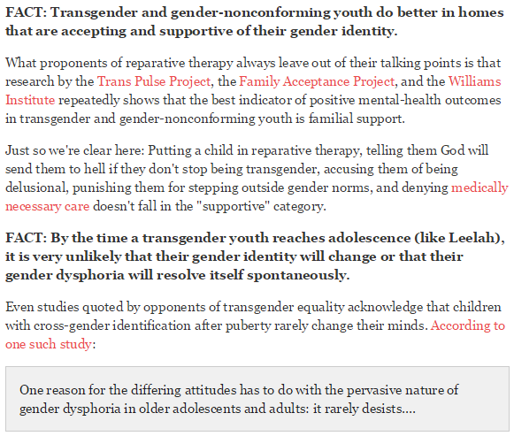
In Writing

Slide 6
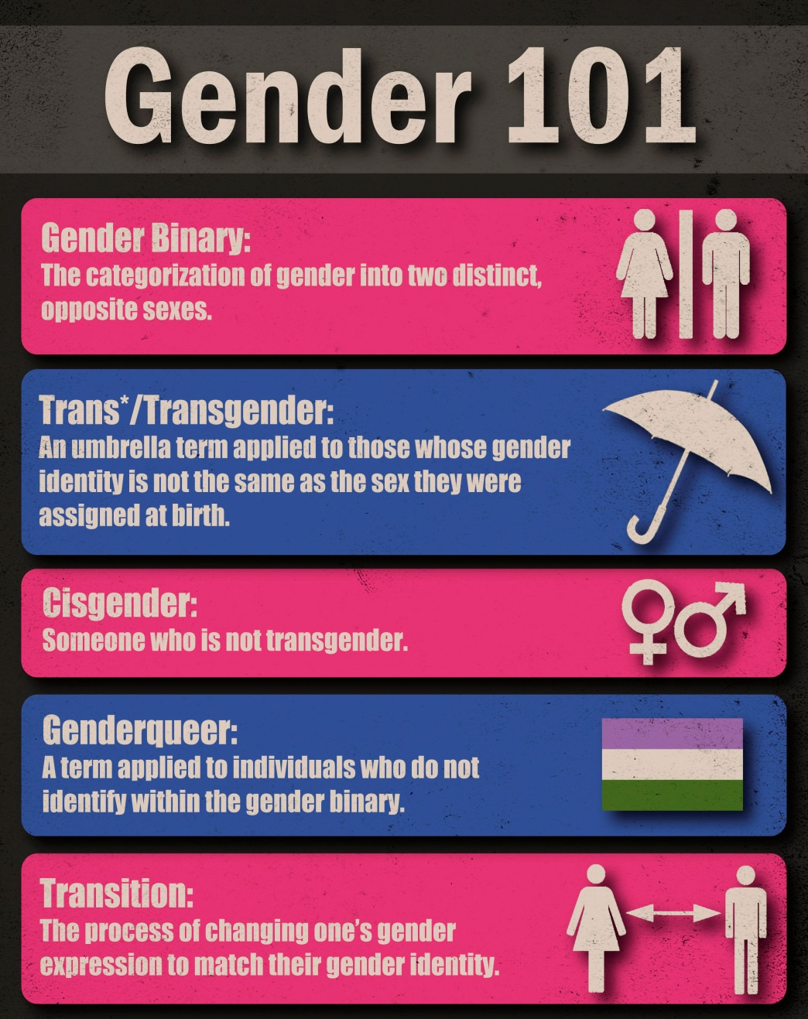
Transgender 101: Basic Definitions

Slide 7
Transgender 101: Identity, Expression, Sex, and Orientation

Slide 8
Just the Facts…
Gender identity is real and has biological origins
Transgender people aren’t mentally ill
Trans people benefit from affirming medical care
Transition is not all about sex
Minority stress and lack of medical care drive of trans suicide rates
Major professional medical / mental health orgs supports access
Transgender people rarely regret transition

Slide 9
Gender identity is real and has a biological origins
"...We conclude that there is sufficient evidence that EDCs modify behavioral sexual dimorphism in children, presumably by interacting with the hypothalamic-pituitary-gonadal (HPG) axis." Winneke et al, Environmental health perspectives, 2013
"Gender-dependent differentiation of the brain has been detected at every level of organization--morphological, neurochemical, and functional--and has been shown to be primarily controlled by sex differences in gonadal steroid hormone levels during perinatal development." Chung and Wilson, European Journal of Physiology, 2013
"In this study, more than 150 individuals with confirmed or suspected prenatal diethylstilbestrol (DES) exposure reported moderate to severe feelings of gender dysphoria across the lifespan." Kerlin, Paper prepared for the International Behavioral Development Symposium, 2005
"Secondly, as predicted twin girls where one displayed gender dysphoria had a more masculine pattern of cerebral lateralization, than non-transgender girls. These findings support the notion of an influence of prenatal T on early brain organization in girls." Cohen-Bendahan; Buitelaar; van Goozen; and Cohen-Kettenis, Psychoneuroendocrinology, 2004
Same (bad) logic used with:
Sexual Orientation
Climate change
Evolution
Smoking
I didn’t see it happen, therefor there’s no proof
Based on biblical world view of “God made man and woman”
“I don't believe we have definitive data (although many psychiatrists with very impressive credentials, who seem to mean well, assert that we do) that any male or female soul has ever in the history of the world been born into the wrong anatomic gender.
Let me put that more clearly: I am not convinced by any science I can find that people with definitively male DNA and definitively male anatomy can actually be locked in a cruel joke of nature because they are actually female.” – Fox News Medical A-Team Contributor Keith Ablow
Over 100 studies (human and animal) show links between pre-natal testosterone exposure, gender identity, and gendered behaviors
Studies show transgender people’s BSTc region of the brain more closely resembles the gender they identify with

Slide 10
Being trans is not a mental illness
Because the people who define what a mental illness is (American Psychiatric Association), say it isn’t for starters:
“It is important to note that gender nonconformity is not in itself a mental disorder. The critical element of gender dysphoria is the presence of clinically significant distress associated with the condition.”
Because transgender people function as well as cisgender people when given proper medical care:
“Male-to-female and FM individuals had the same psychological functioning level as measured by the Symptom Checklist inventory (SCL-90), which was also similar to the psychological functioning level of the normal population and better than that of untreated individuals with GID.” - Murad, M., et al. (2010)
“The mental health quality of life of trans women without surgical intervention was significantly lower compared to the general population, while those transwomen who received FFS, GRS, or both had mental health quality of life scores not significantly different from the general female population.” - Ainsworth & Spiegel, (2010)
The American Psychiatric Association does not define transgender identities as intrinsically disordered, because they do not meet the definition
Being transgender does not necessarily affect an individual’s ability to function

Slide 11
Trans people benefit greatly from affirming medical care
What the Karolinska Institute Study (Dehjne, et al. 2011) REALLY said
“For the purpose of evaluating whether sex reassignment is an effective treatment for gender dysphoria, it is reasonable to compare reported gender dysphoria pre and post treatment. Such studies… suggest that sex reassignment of transsexual persons improves quality of life and gender dysphoria.”
“In accordance, the overall mortality rate was only significantly increased for the group operated on before 1989. However, the latter might also be explained by improved health care for transsexual persons during 1990s, along with altered societal attitudes towards persons with different gender expressions.”
“sex-reassigned individuals were also at a higher risk for suicide attempts, though this was not statistically significant for the time period 1989–2003.
“It (the study) does not, however, address whether sex reassignment is an effective treatment or not.” (No control group comparison)
“This contrasts with previous reports (with one exception) that did not find an increased mortality rate after sex reassignment, or only noted an increased risk in certain subgroups.”
SUMMARY: This study isn’t about the effectiveness of GRS, we’re the only ones who found this, it’s not significant after 1989, and societal attitudes started changing about the same time the differences became non-significant
“An established body of medical research demonstrates the effectiveness and medical necessity of mental health care, hormone therapy and sex reassignment surgery as forms of therapeutic treatment for many people diagnosed with GID .... Health experts in GID, including WPATH, have rejected the myth that such treatments are 'cosmetic' or 'experimental' and have recognized that these treatments can provide safe and effective treatment for a serious health condition.” AMA Resolution 122
“Summarizing the results from the 18 outcome studies of the last 2 decades, the conclusion that SRS is the most appropriate treatment to alleviate the suffering of extremely gender dysphoric individuals still stands ....” Gijs, L., & Brewaeys, A. (2007)]
“[t]here were few negative consequences, and all aspects of the reassignment process contributed to overwhelmingly positive outcomes.” Monstrey et al. 2007
“[s]ex reassignment surgery has been part of the treatment of transsexuality for >70 years and is widely accepted as therapeutic.” Annette Kuhn et aI., 2009
Who Is Dr. Paul McHugh?
Denies medical evidence of biological origins of gender identity
Self described Conservative Catholic
Opposed to abortion in ALL circumstances
Helped cover up Priest child abuse scandals
Blamed problem on “homosexuals”
Has not worked with transgender people in >35 years
Results have never been reproduced
Study pulled from a hand picked sample
Work denounced by Johns Hopkins in testimony before MD state senate in 2011
“We at Johns Hopkins University—which in the 1960s was the first American medical center to venture into "sex-reassignment surgery"—launched a study in the 1970s comparing the outcomes of transgendered people who had the surgery with the outcomes of those who did not. Most of the surgically treated patients described themselves as "satisfied" by the results, but their subsequent psycho-social adjustments were no better than those who didn't have the surgery. And so at Hopkins we stopped doing sex-reassignment surgery, since producing a "satisfied" but still troubled patient seemed an inadequate reason for surgically amputating normal organs.
…A 2011 study at the Karolinska Institute in Sweden produced the most illuminating results yet regarding the transgendered, evidence that should give advocates pause. The long-term study—up to 30 years—followed 324 people who had sex-reassignment surgery. The study revealed that beginning about 10 years after having the surgery, the transgendered began to experience increasing mental difficulties. Most shockingly, their suicide mortality rose almost 20-fold above the comparable nontransgender population. This disturbing result has as yet no explanation but probably reflects the growing sense of isolation reported by the aging transgendered after surgery. The high suicide rate certainly challenges the surgery prescription.” – Dr. Paul McHugh
The benefits of medical care, and the consequences of lack a lack thereof, have led the medical community to conclude that transgender specific care meets the definition of “medically necessary”

Slide 12
Transition is not about sex
No true Scotsman fallacies everywhere
Any female attracted trans woman who says they aren’t an autogynephile is lying
Any male attracted transwoman who imagines herself during sex as female is lying
When cisgender women were given same survey Blanchard used, 93% met his criteria for being autogynephiles (Moser 2009)
Essentially, any sexuality a transwoman has is disordered
No mention of transgender men
Occams razor: mental self image is part of everyone’s sexuality, and that people who prefer women fantasize about women
Blanchard’s Typology
Does not recognize gender identity as real
Classifies all transwomen as either
Self hating homosexual men
Heterosexual men with a paraphilia (autogynephilia)
Postulates that the act of sex is reason for all transitions
Believes homosexuality should be back in DSM, all non-reproductive sex is abnormal
Catholic….
Admitted to making up other diagnoses out of whole cloth, trying to put them in DSM
This is Norah Vincent
Writer for LA Times
Lesbian, not trans
Decided, as a social experiment, to try living as a man for 18 months
Ended up in mental institution in 12 because the strain of trying to live in the wrong gender became that unbearable
Wrote a book about the experience called “Self Made Man”
Vast majority of modern studies show significant (non-sexual) benefits for transgender individuals
Post transition individuals statistically same as cisgender population on symptom assessment checklist (DeCuypere, 2006)
Suicide attempt rate reduced by 83% (DeCuypere, 2006)
Romantic partnerships were reported as being more common and easier to maintain (Lobato 2006)
Resolves body image issues (dysphoria) (Zimmerman 2006, Fisher 2014)
Reduced psychological co-morbidity (Murad, 2010, Colizzi 2013, Gorin-Lazard, 2013)
Improved social quality of life (Parola 2010, Gómez-Gil, Esther et al., 2012)
Reduced cortisol response rate (Colizzi 2013)
Improved self-esteem (Gorin-Lazard, 2013)
Most of the benefits of transition, and medical care supporting transition, have nothing to do with sex
Liar!

Slide 13
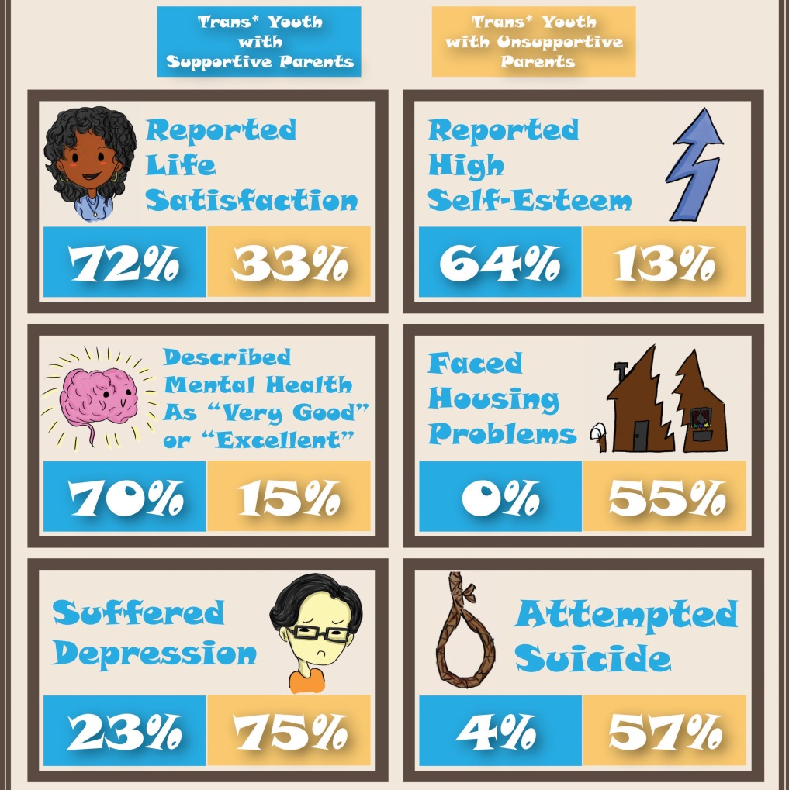
Minority stress, discrimination, and lack of medical care drive of trans suicide rates
Many studies show transgender people have similar mental health outcomes when given access to transition related health care (Smith 2005, DeCuypere 2006, Wyers 2009, Murad 2010, Ainsworth 2010)
As societal attitudes towards transgender people have improved, so have outcomes (Dhejne 2011)
Much better outcomes in supportive / non-discriminatory environments (TransPulse Project, 2012, Moody 2013, Haas 2014)
Dr. Kenneth Zucker
Reparative therapist for “sissy boys” in 80’s
Used to claim he could prevent homosexuality
Now claims he can prevent trans
Rejects gender identity
Uses coercive behavioral modification
Data set bias / lack of control groups
No evidence you wouldn’t get same result without “therapy”
Claimed no one would accept homosexuals in 90’s
Now says he does it because society will never accept trans people
Familial rejection of transgender youth identities leads to suicide attempt rates in excess of 50%
“If your daughter truly is confused, if she’s really starting to think she’s a boy, then you are only going to enforce her delusions when you go out of your way to put her in elaborate outfits specifically designed to foster those confusions…
Harsh? Not nearly harsh enough. This girl is being abused, and we’re all watching and applauding.” Conservative Blogger Matt Walsh, June 3, 2014
Studies repeatedly show that lack of medical care, mistreatment, discrimination, and familial rejection are the causes of high transgender suicide attempt rates

Slide 14
The following organizations have issued position statements supporting transgender affirming care, opposing discrimination:
American Medical Association (Resolution 122)
American Psychiatric Association
American Psychological Association
American Academy of Family Physicians (Resolution 1004-2012)
American Academy of Physician Assistants
American College of Nurse Midwives
National Association of Social Workers
World Professional Association of Transgender Health
National Commission on Correctional Health Care
American Public Health Association
American College of Obstetricians and Gynecologists
Opponents claim organizational positions are a result of :
“Liberal / progressive bias”
“Political correctness”
Logical errors include:
“Medicine has been wrong before”
Confirmation bias
Chromosomes
Conflating identity with biology
Anecdotal evidence
“Gender identity is entirely subjective…”
Occam’s Razor: It’s much more likely these organizations have arrived at these positions in consensus after decades of peer reviewed research.
“An established body of medical research demonstrates the effectiveness and medical necessity of mental health care, hormone therapy and sex reassignment surgery as forms of therapeutic treatment for many people diagnosed with GID… Therefore, be it RESOLVED, that the AMA supports public and private health insurance coverage for treatment of gender identity disorder.”
“Being transgender or gender variant implies no impairment in judgment, stability, reliability, or general social or vocational capabilities; however these individuals often experience discrimination due to a lack of civil rights protections for their gender identity or expression… The American Psychiatric association opposes all public and private discrimination against transgender individuals in such areas as health care, employment, housing, public accommodation, education, and licensing”
“As stated in the Policy on Transgender, Gender Identity & Gender Expression Non-Discrimination, the American Psychological Association “opposes all public and private discrimination on the basis of actual or perceived gender identity and expression and urges the repeal of discriminatory laws and policies” and “calls upon psychologists in their professional roles to provide appropriate, nondiscriminatory treatment to transgender and gender variant individuals and encourages psychologists to take a leadership role in working against discrimination towards transgender and gender variant individuals[.]”
Major professional medical / mental health orgs support access
The official medical and mental health care communities’ positions on transgender care are a matter of public record

Slide 15
Anecdotal appeals to emotion
Dismissal of peer reviewed evidence
Anecdotal evidence is used to argue no one should have access to affirming medical care
Opposition material about “regret” are a form of “concern trolling”
Deliberate mis-use of suicide statistics
Ignores the research showing more access / affirmation reduces rates
Vast majority haven’t had surgery
The regret rate can be reduced further by more educated medical / mental health professionals
Regret rates for trans care is far lower than other medical procedures
Many recent studies put major / consistent regret rates for Gender Reassignment Surgery at 1-4% (Cohen-Kettenis & Pfafflin 2003, Kuiper & Cohen-Kettenis 1998, Smith 2005, Dhejne 2014.
In other studies, NONE of the subjects expressed consistent / major regret in transitioning (Krege 2001, Lobato 2006, DeCuypere 2006, Lawrence 2006, Wyers 2009, Garcia 2014)
Some of the same studies show that >94% have NO regrets at all. (Smith 2005, Lawrence 2006, Wyers 2009)
Regret rate is dropping over time as surgical techniques have improved (Dhejne 2014)
Compare: Up to 65% of people getting cosmetic surgery in UK regret it, with as little as 28% being happy with the result.
Transgender people rarely regret transition
“Walt Heyer is perhaps the most active among the survivors out there, and possibly the most vilified by transgender activists. He is a clear-eyed and gentle man, now in his 70s, who had sex reassignment surgery and lived as a woman for many years. Because of the devastation sown by the gender confusion, Heyer offers information and support in blogs.
Heyer has also authored three relevant books that provide resources to understand the destructive effects of gender confusion. He cites, for example, a national survey of more than 6,500 transgenders that asked the question, “Have you tried to commit suicide?” Forty-one percent answered, “Yes.” One need look no further for compelling evidence of widespread transgender and sex change regret.” – Stella Morabito, The Federalist November 11, 2014
Studies over the past decade show transgender people very rarely have serious regrets, and the vast majority have none at all

Slide 16
Gender identity is real and has biological origins: Trans people are who they say they are

Slide 17
Transgender people aren’t mentally ill: they are perfectly capable of functioning at the highest levels

Slide 18
Trans people benefit from affirming medical care: decades of peer reviewed medical research has created an overwhelming medical consensus

Slide 19
Transition is not all about sex: most of the benefits derived from transition have nothing to do with sex or orientation

Slide 20
Minority stress and lack of medical care drive of trans suicide rates: peer reviewed evidence consistently shows bringing down trans suicide rates requires a more affirming society, not one that is less so.

Slide 21
Major professional medical / mental health orgs support access: Virtually every doctor, physician’s assistant, psychiatrist, psychologist, and social worker belongs to an organization on record supporting access to care and non-discrimination

Slide 22
Transgender people rarely regret transition: every peer reviewed study of regrets over the past decade shows > 94% have no regrets over surgery.

